Slide 1
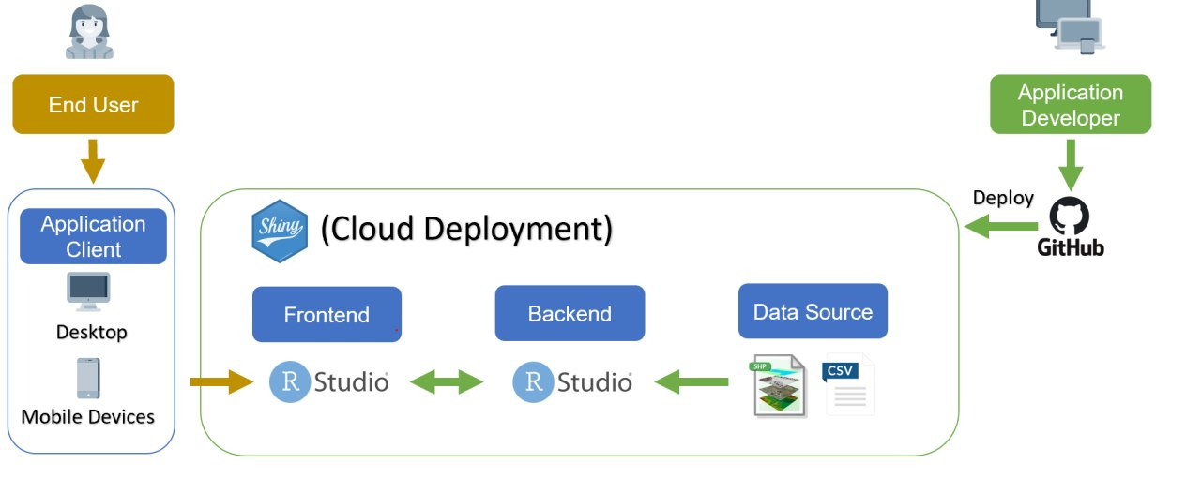

Slide 2
Key Challenges | Mitigation
Unfamiliar with R | Self-learning with the help of Datacamp Research on UI layout formats and UI components
Unfamiliar with new packages | Look up on past projects that has adopted similar analysis with the required packages Conduct individual research and hold weekly sharing session Consult Prof Kam if required
Data obtained not well formatted | Implement any additional Data Wrangling methods if required
Unfamiliar with R Shiny | Conduct extra researches to look for packages' dependencies Consult Prof Kam if required

Slide 3
R Packages | Function
sp, sf, rgdal, tidyverse | Data Cleaning Data Wrangling
ggplot2, tmap, leaflet | Exploratory Data Analysis graph visualisations Spatial map visualisation
spatstat, raster, maptools, gstat | Thiessen Polygons creation Raster layer creation
Shiny, shinydashboard, shinyWidgets, shinythemes | R Shiny Widgets UI Customisations

Slide 4
Key Milestones | Week 6 | Week 7 | Week 8 | Week 9 | Week 10 | Week 11 | Week 12 | Week 13 | Week 14
Project Research
R Shiny Workshop
Milestone 1: Project Proposal (12th October 2020, 2359hrs)
Geospatial Analysis: Spatial Point Pattern Analysis Temporal Spatial pattern analysis Geostatistics & Spatial Interpolation
Milestone 2: 1st Application Iteration (26th to 31st October 2020, 1hr timeslot)
Final Project deliverables: Finetuning Geospatial Analysis Project Poster, Video & Research paper
Milestone 3: Final Project Submission (22nd November 2020, 2359hrs)

Slide 5
Data Variable | Description
Latitude, Longitude, Track | Center of 1km fire pixel but not necessarily the actual location of the fire as one or more fires can be detected within the 1km pixel. Data type: Double.
Brightness | Channel 21/22 brightness temperature of the fire pixel measured in Kelvin. Data type: Double.
Scan | The algorithm produces 1km fire pixels, but MODIS pixels get bigger toward the edge of scan. Scan and track reflect actual pixel size. Data type: Double.
Acq_Date | Date of MODIS acquisition. Data type: Date.
Acq_Time | Time of acquisition/overpass of the satellite (in UTC). Data type: String.
Satellite | A = Aqua and T = Terra. Data type: String.
Confidence | This value is based on a collection of intermediate algorithm quantities used in the detection process. It is intended to help users gauge the quality of individual hotspot/fire pixels. Confidence estimates range between 0 and 100% and are assigned one of the three fire classes (low-confidence fire, nominal-confidence fire, or high-confidence fire). Data type: Integer.
Version | Version identifies the collection (e.g. MODIS Collection 6) and source of data processing: Near Real-Time (NRT suffix added to collection) or Standard Processing (collection only). Data type: String.
Bright_T31 | Channel 31 brightness temperature of the fire pixel measured in Kelvin. Data type: Double.
FRP | Depicts the pixel-integrated fire radiative power in MW (megawatts). Data type: Double.
DayNight | D = Daytime, N = Nighttime. Data type: String.

